Slide 1
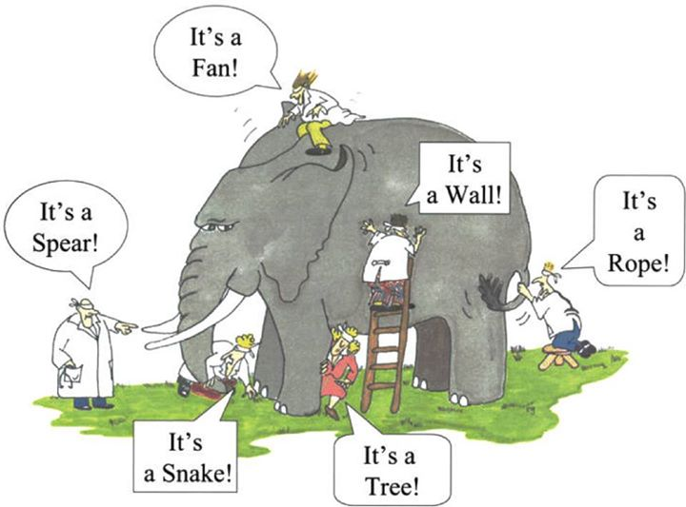

Slide 2
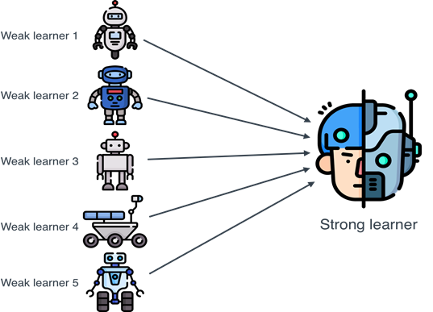
Boost Accuracy with Multiple Models
Ensemble Learning in machine learning that integrates multiple models called as weak learners to create a single effective model for prediction.
This technique is used to enhance accuracy, minimizing variance and removing overfitting.

Slide 3
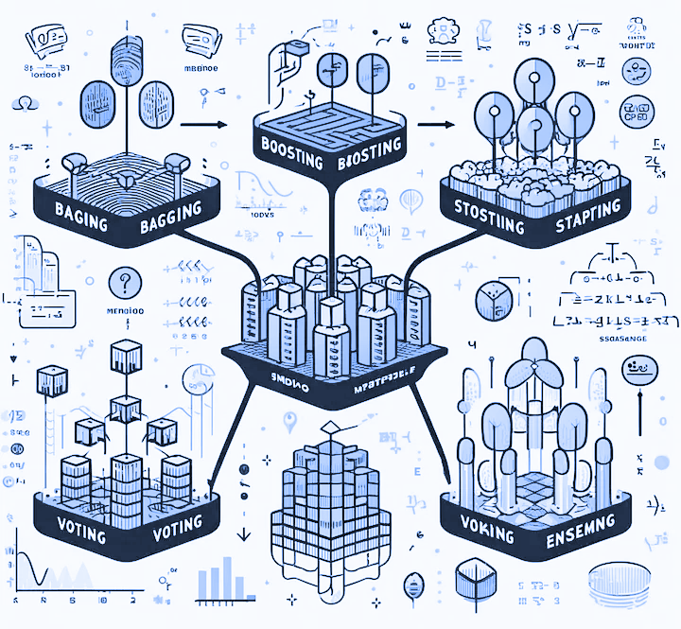

Slide 4
Ensemble
Ensemble learning is a machine learning paradigm that involves generating an ensemble of models, which can include training constituent models on resampled datasets and combining them in some form, such as averaging, to provide predictions of target variables of interest.
At its core, ensemble learning represents a strategy where multiple individual models, often referred to as base learners, collaboratively work together to improve overall predictive performance.
The main premise is that by combining multiple models, the errors of a base learner will likely be compensated by other base learners, resulting in higher prediction performance of the ensemble compared to a single base learner.
This approach harnesses the wisdom of the crowd, leveraging diverse viewpoints to create a final model that outperforms any of its constituent parts.

Slide 5
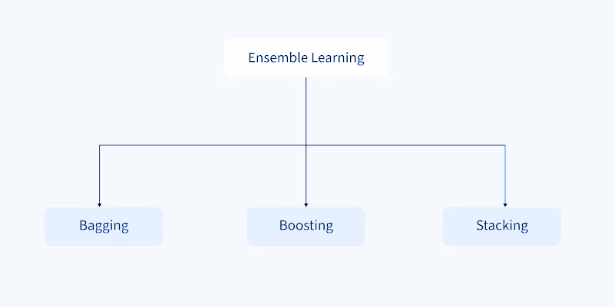
Types of Ensemble Learning

Slide 6
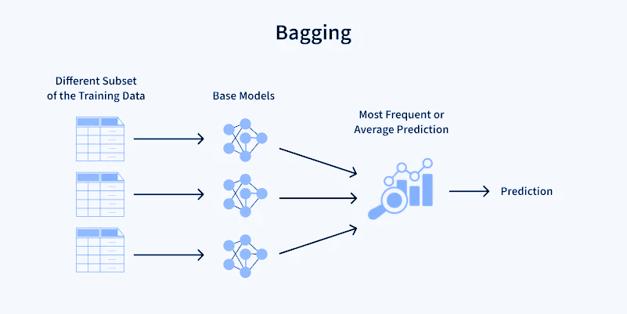
Bagging : Bagging is a technique that involves creating multiple versions of a model and combining their outputs to improve overall performance.

Slide 7
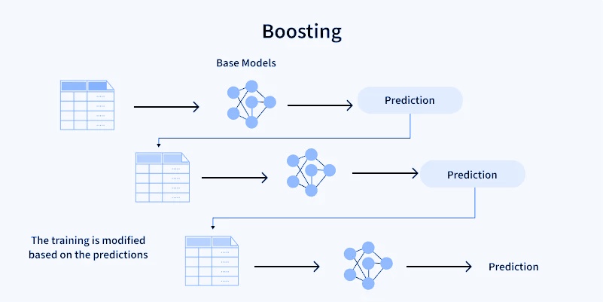
Boosting : Boosting is an ensemble technique where multiple models are trained sequentially, with each new model attempting to correct the errors made by the previous ones.

Slide 8
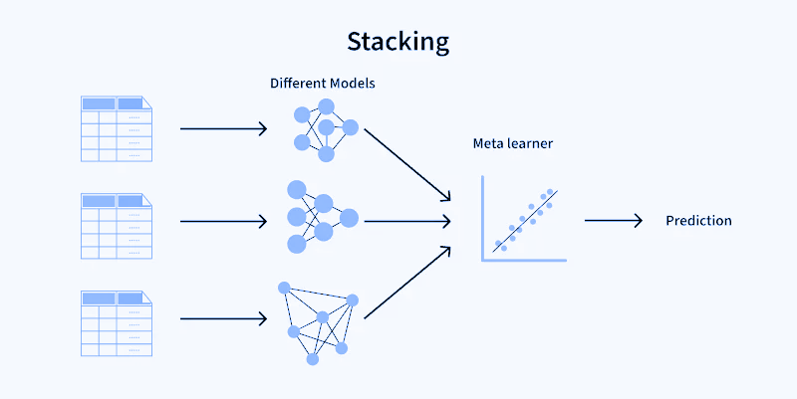
Stacking :

Slide 9
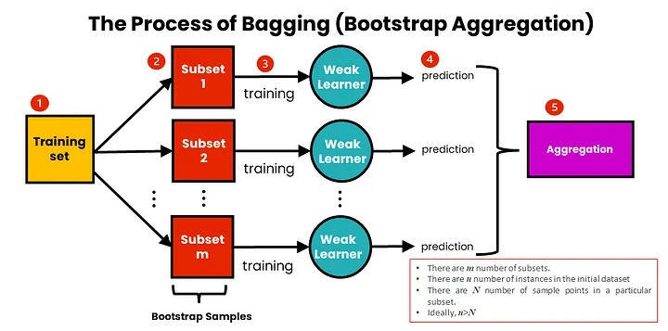
Bagging (Bootstrap Aggregating)
Overview: Bagging involves training multiple models on different random subsets of the training data and then aggregating their predictions. The most well-known example is the Random Forest algorithm.
Pros:
Reduces Variance: By training models on different subsets, bagging reduces the variance, leading to more stable and robust models.
Parallel Training: Models can be trained independently, making the process parallelizable and faster.
Cons:
Limited Reduction of Bias: Bagging primarily reduces variance but may not significantly reduce bias if the base models are biased.
Use Cases:
Random Forests for classification and regression tasks.

Slide 10
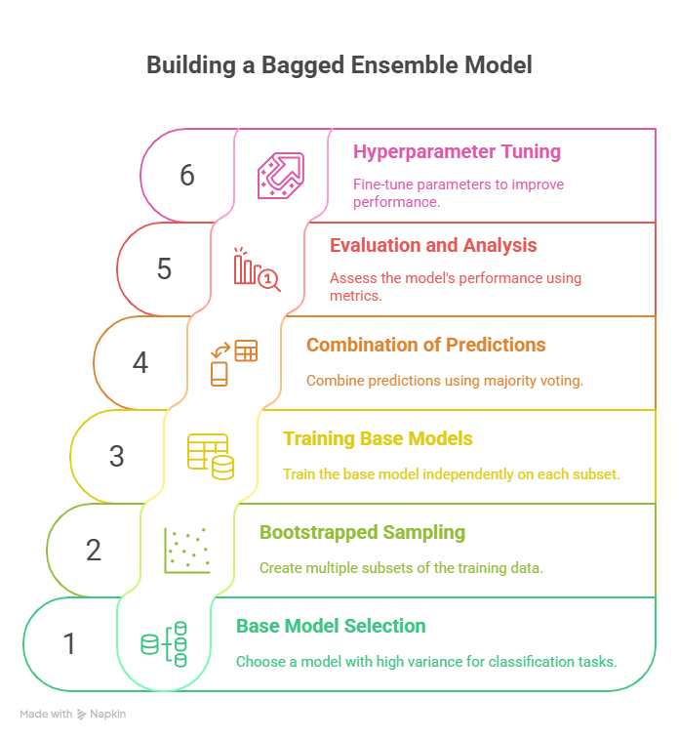
Steps in Bagging
Base Model Selection: We can start with a base model like a decision tree or a random forest classifier, which are known to perform well on classification tasks and have a high variance, making them prone to overfitting.
Bootstrapped Sampling: Using bootstrapped sampling, we produce multiple subsets of the training data. Assume we make ten subsets (or “bags”) of the training data, each with a random sampling of 80% of the original data and replacement. This means that some samples will be repeated in each bag, while others will be skipped.
Training the Base Model: We train the base model (e.g., a decision tree) independently on each bag of training data. Fitting the decision tree to each bag and obtaining the model parameters or weights is what this entails.
Combination of Prediction Models: Once all of the base models have been trained, we may use them to make predictions on the test data. The underlying models’ forecasts can be blended using majority voting. For example, if six out of ten base models predict a tumor to be malignant, we can take the majority vote and declare the tumor to be malignant.
Evaluation and Performance Analysis: We assess the bagged ensemble model’s performance using appropriate evaluation metrics such as accuracy, precision, recall, and F1-score. To assess the improvement in model performance, we compare the performance of the bagged ensemble model to the performance of the base model.
Hyperparameter Tuning: To improve model performance, we can fine-tune the hyperparameters of the basic model and the bagging ensemble. To discover the optimum combination for a specific problem, we can experiment with alternative hyperparameter values, such as the number of base models in the ensemble, the sampling ratio for bootstrapped sampling, and the type of prediction combination method.

Slide 11
Common Algorithm
1. Random Forest
Random forest is an ensemble method based on decision trees. Multiple decision trees are trained using different bootstrapped samples of the data.
In addition to bagging, Random Forest also introduces randomness by selecting a random subset of features at each node, further reducing variance and overfitting.
2. Bagged Decision Trees
In Bagged Decision Trees, multiple decision trees are trained using bootstrapped samples of the data.
Each tree is trained independently and the final prediction is made by averaging the predictions of all the trees in the ensemble.

Slide 12
Summary
Bagging trains multiple models on different bootstrap samples of the training data, reducing variance and improving stability, especially for high-variance algorithms like decision trees.
Random Forests are prominent examples, where each tree is trained on a random subset of data and features, and predictions are combined by majority voting or averaging.

Slide 13
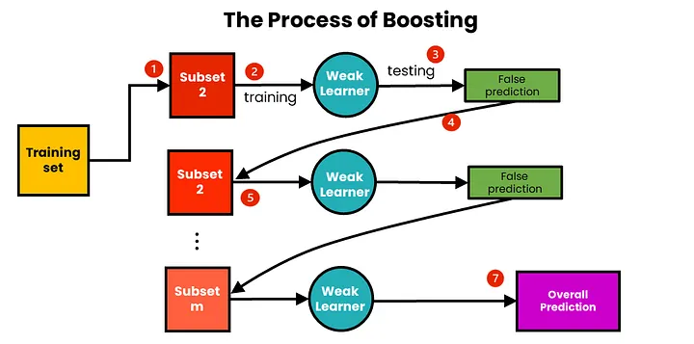
Boosting
Overview: Boosting trains models sequentially, where each new model attempts to correct the errors made by the previous ones. Examples include AdaBoost, Gradient Boosting Machines (GBM), and XGBoost.
Pros:
Reduces Bias and Variance: Boosting can reduce both bias and variance, leading to high predictive accuracy.
Handles Complex Relationships: Capable of capturing complex data patterns.
Cons:
Risk of Overfitting: If not properly regularized, boosting can overfit the training data.
Sequential Training: Models are trained sequentially, which can be slower compared to parallelizable methods like bagging.
Use Cases:
AdaBoost for binary classification.
XGBoost and LightGBM for structured data and competitions like Kaggle.

Slide 14
Boosting
Boosting sequentially trains models, with each new model focusing on correcting the errors of its predecessor, thereby reducing bias.
AdaBoost, Gradient Boosting, and XGBoost are widely used boosting algorithms, with AdaBoost assigning weights to misclassified samples and XGBoost incorporating regularization and gradient-based optimization

Slide 15
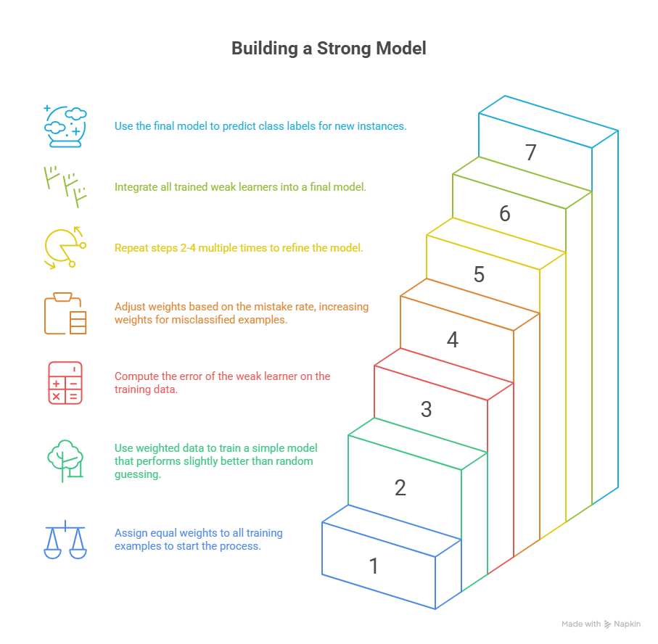
Boosting
Initialise weights: At the start of the process, each training example is given equal weight.
Train a weak learner: The weighted training data is used to train a weak learner. A weak learner is a simple model that outperforms random guessing only marginally. A decision tree with a few levels, for example, can be employed as a weak learner.
Error calculation: The error of the weak learner on the training data is computed. The weighted sum of misclassified cases constitutes the error.
Update weights: Weights are updated according to the mistake rate of the training examples. Misclassified examples are given higher weights, whereas correctly classified examples are given lower weights.
Repeat: Steps 2–4 are repeated several times. A new weak learner is trained on the updated weights of the training examples in each cycle.
Combine weak learners: The final model is made up of all of the weak learners that were trained in the preceding steps. The accuracy of each weak learner is weighted, and the final prediction is based on the weighted total of the weak learners.
Forecast: The finished model is used to forecast fresh instances’ class labels.

Slide 16
Common Algorithms Using Boosting
1. AdaBoost (Adaptive Boosting)
AdaBoost works by adjusting the weights of misclassified instances and combining the predictions of weak learners (usually decision trees). Each subsequent model is trained to correct the mistakes of the previous model.
AdaBoost can significantly improve the performance of weak models, especially when used for classification problems.
2. Gradient Boosting
Gradient Boosting is a more general approach to boosting that builds models sequentially, with each new model fitting the residual errors of the previous model.
he models are trained to minimize a loss function, which can be customized based on the specific task.
We can perform regression and classification tasks using Gradient Boosting.
3. XGBoost (Extreme Gradient Boosting)
XGBoost is an optimized version of gradient boosting. It includes regularization to prevent overfitting and supports parallelization to speed up training.
XGBoost has become a popular choice in machine learning competitions due to its high performance.

Slide 17
Feature | AdaBoost | Gradient Boosting (GBM) | XGBoost
Base idea | Reweight misclassified samples | Fit new model on residuals | Optimized GBM with regularization
Error handling | Increases weight of errors | Models gradient of loss function | Uses gradient + 2nd order approximation
Loss function | Exponential (default) | Any differentiable loss (MSE, log-loss) | Any differentiable loss + regularization
Speed | Moderate | Slower | Very fast (parallelized, optimized)
Overfitting | Prone (esp. noisy data) | Prone (without tuning) | Controlled with L1/L2 regularization
Best for | Simple problems, clean datasets | Flexible tasks (regression/classification) | Large-scale, high-accuracy tasks (Kaggle)

Slide 18
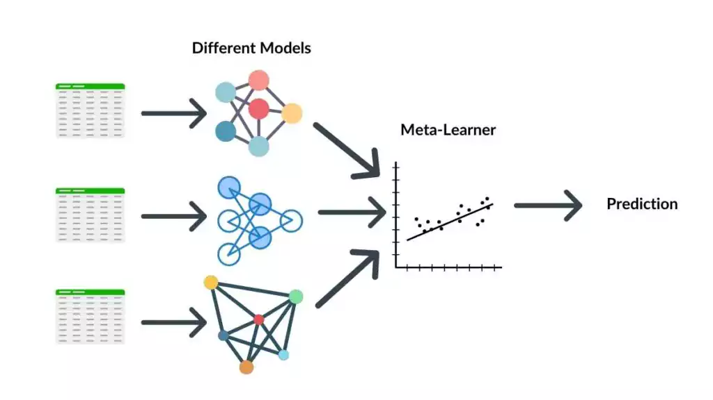
Stacking
Overview: Stacking involves training multiple base models and then using their predictions as input features for a higher-level meta-model, which makes the final prediction.
Pros:
Combines Strengths: Leverages the strengths of diverse models by combining their predictions.
Flexibility: Can use any type of model for both base learners and the meta-model.
Cons:
Complexity: Requires careful selection and tuning of both base models and the meta-model.
Computationally Intensive: Can be resource-intensive due to the training of multiple models and the meta-model.
Use Cases:
Complex tasks requiring high accuracy, such as competition datasets and research projects.

Slide 19
Stacking (Stacked Generalization)
Stacking combines heterogeneous models by training a meta-learner on the outputs of base models, aiming to improve predictive accuracy and generalization.
In stacking, base learners’ predictions are used as input features for the meta-learner, which learns how to best combine them.
The bias-variance tradeoff is central to ensemble learning: bagging primarily reduces variance, boosting reduces bias, and stacking seeks to optimize both by leveraging model diversity and meta-learning.
Weak learners, which perform slightly better than random guessing, are often used as building blocks in boosting and stacking to construct stronger models.
Balancing bias and variance is essential to avoid underfitting and overfitting, ensuring robust and accurate ensemble models.

Slide 20
Common Algorithms Using Stacking
1. Generalized Stacking
In Generalized Stacking, multiple different models (e.g., decision trees, logistic regression, neural networks) are trained on the same dataset.
And a meta-model (such as a logistic regression or another decision tree) is trained on the predictions made by th andese base models.
The meta-model learns how to combine the predictions of the base models to make the final prediction.
2. Stacking with Cross-Validation
In stacking with cross-validation, the base models are trained using cross-validation and their predictions on the validation set are used to train the meta-model.
This prevents overfitting and ensures that the meta-model is trained on unbiased data.
3. Multi-Layer Stacking
Multi-layer stacking involves multiple levels of base models, where the outputs of the first level of models are fed into a second level of base models and so on, before reaching the meta-model.
This approach creates a more complex ensemble that can capture a wider variety of patterns in the data.

Slide 21
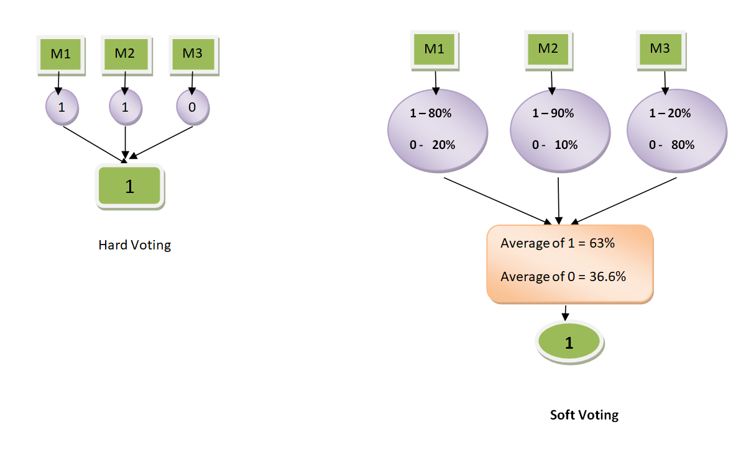
Voting
Overview: Voting ensembles combine the predictions of multiple models by taking a majority vote (for classification) or averaging (for regression). It can be hard (majority vote) or soft (weighted probabilities).
Pros:
Simple and Effective: Easy to implement and often provides a performance boost.
Reduces Overfitting: Aggregates multiple models to smooth out individual biases.
Cons:
Equal Weighting: Simple voting treats all models equally, which may not always be optimal.
Use Cases:
Initial ensemble method for improving model robustness in classification tasks.

Slide 22
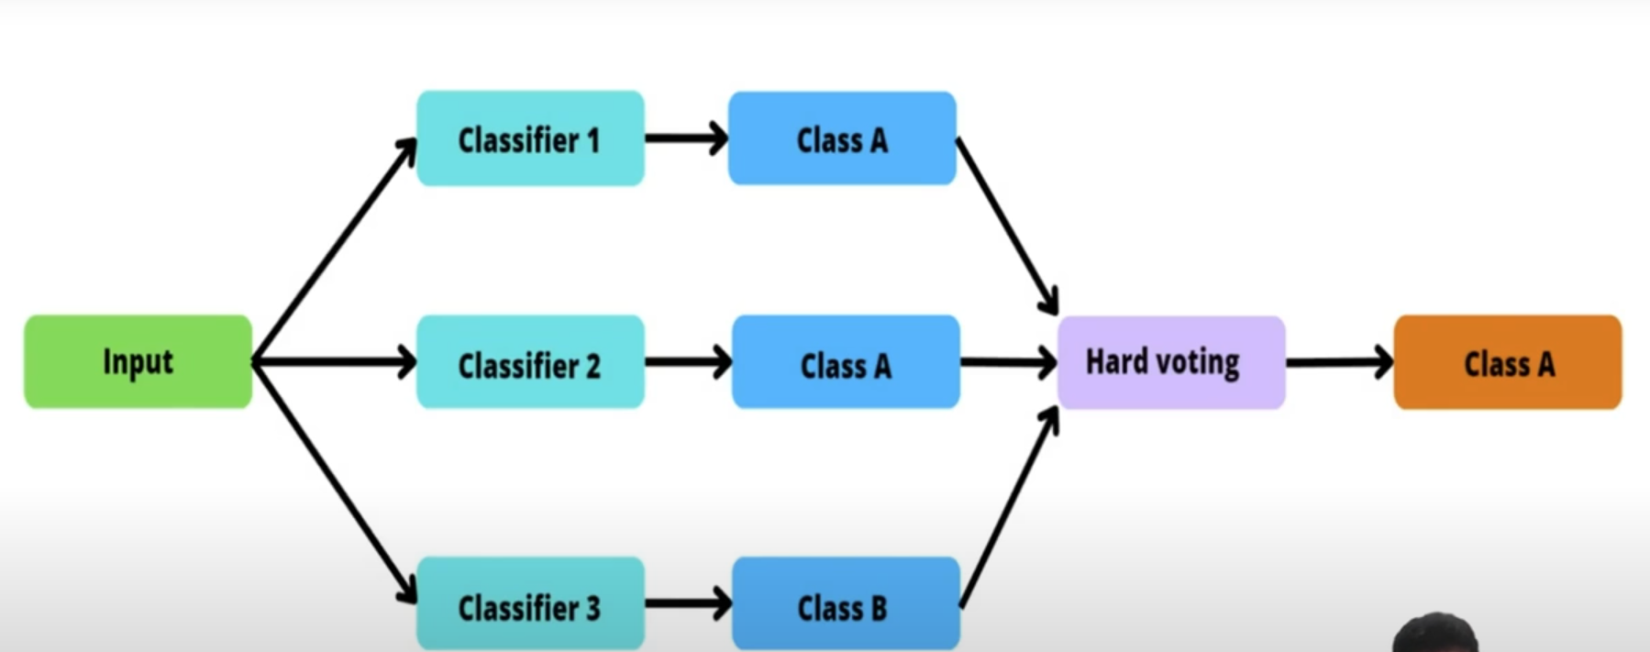
Hard Voting

Slide 23
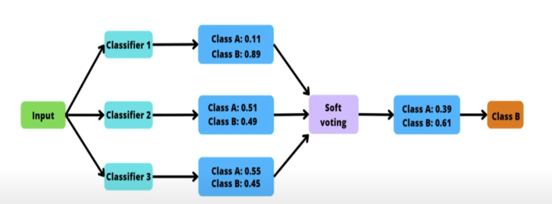
Soft Voting

Slide 24
Weighted Ensemble
Overview: A weighted ensemble assigns different weights to models based on their performance, combining their predictions accordingly.
Pros:
Performance-Based Weighting: Gives more importance to better-performing models, potentially improving accuracy.
Flexibility: Can combine various types of models with custom weights.
Cons:
Weight Tuning: Requires careful tuning of weights, which can be challenging and time-consuming.
Computational Overhead: Maintaining and updating multiple models can be resource-intensive.
Use Cases:
Scenarios where certain models consistently perform better and need higher influence on final predictions.

Slide 25
Base Learners and Ensemble Construction Strategies
Base learners commonly used in ensemble learning include decision trees, neural networks, and support vector machines, among others.
The choice of base learner can significantly affect the performance of the ensemble, as selecting a range of strong learning algorithms that diverge in their predictions is key for good performance.
Homogeneous ensembles utilize the same type of base learner, trained on different data subsets or with different parameters.
Techniques like bagging and boosting are typical examples, where multiple models of the same kind are built from different subsamples or sequentially to correct previous errors.
In contrast, heterogeneous ensembles combine different types of base learners.
Diversity among base learners is crucial for ensemble effectiveness. Strategies for generating diversity include data resampling (e.g., bagging), randomization in training algorithms, and manipulation of output labels.
Diversity is defined as the degree of disagreement between base models, and it allows ensembles to compensate for the mistakes of certain models through the correct predictions of others.
Methods such as random subspace, bagging, and boosting introduce diversity by training base learners on different data subsets or by combining different base learners trained on the same training set. Ensemble pruning methods, including ranking, search-based, and partitioning-based approaches, are used to prune models by removing redundant or less accurate models, aiming to maximize prediction accuracy and reduce computational costs.
https://www.sciencedirect.com/topics/computer-science/ensemble-learning

Slide 26
References
https://www.youtube.com/watch?v=pc9sZz45s94
https://www.youtube.com/watch?v=sN5ZcJLDMaE
https://www.geeksforgeeks.org/machine-learning/types-of-ensemble-learning/

